Slide 1
US Historical Stock Data Analysis with 2 Moving Averages, Bollinger Bands and Regression
Leung Wing Yan MB95524
Lam Tek Hong MB95559
Joseph Yen YB87412

Slide 2
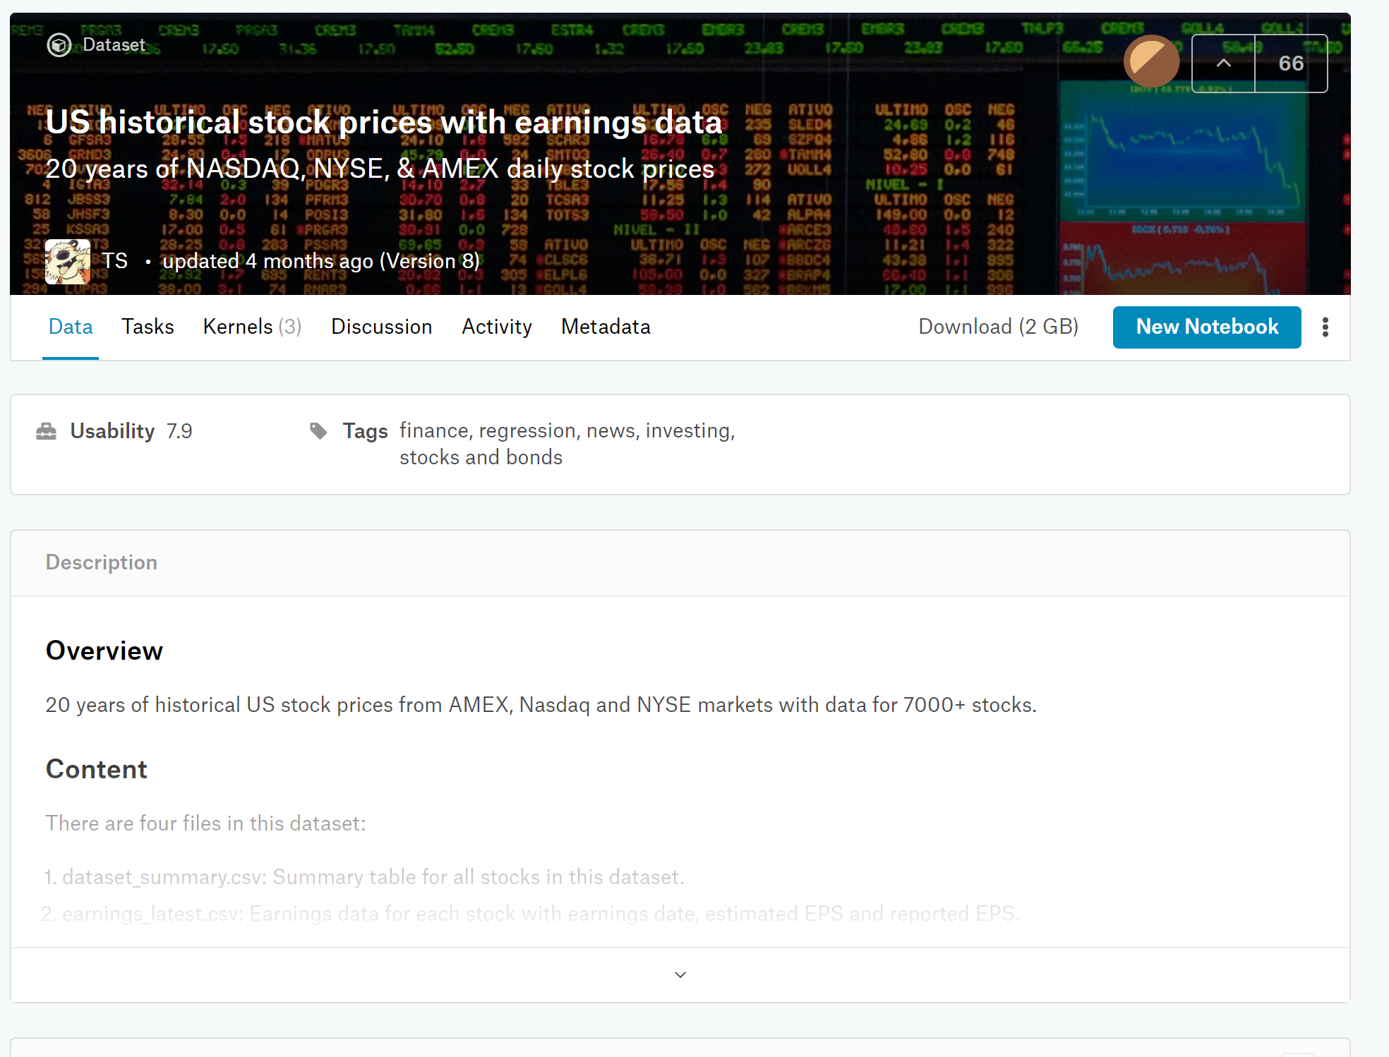
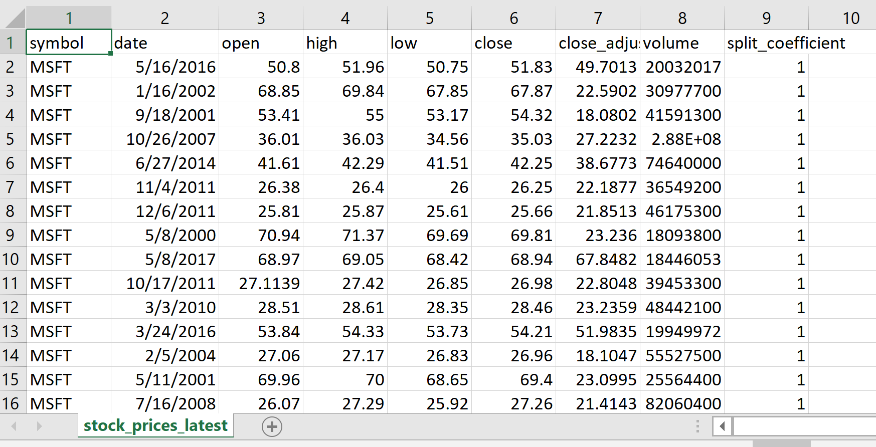
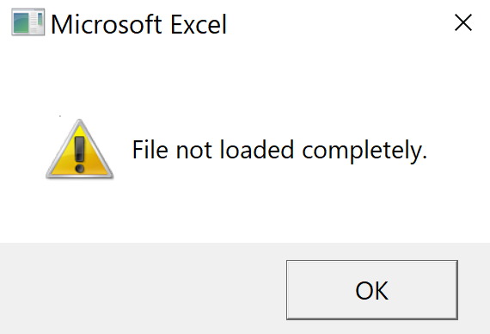

Data Source
US historical stock prices with earning data
Data size: 1.7GB
Stocks: 7091
Period: Jan 2 1998 – Aug 15 2019

Slide 3
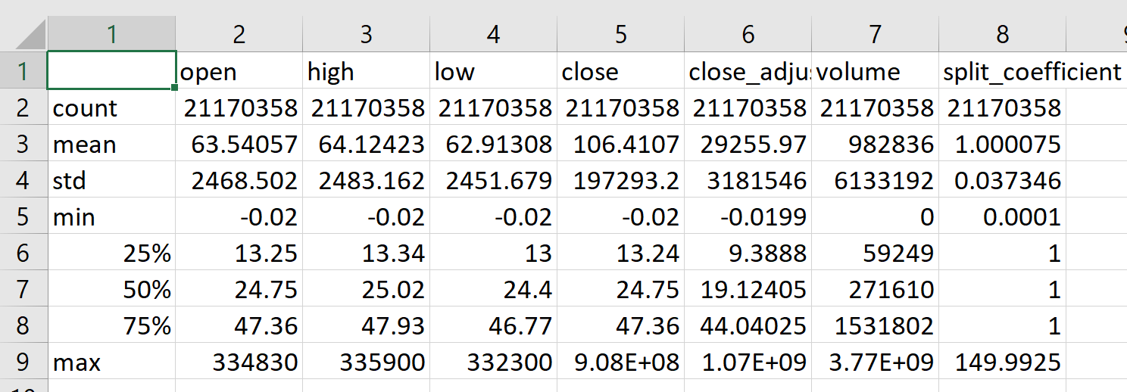
Data analysis
Using Pandas and Dask Library
Dask Library produces the same result and offloads data to hard disk instead of RAM
2.1 million rows x 9 columns.
print(Data.info(memory_usage='deep’))
>>> [8 rows x 7 columns]
<class 'pandas.core.frame.DataFrame'>
RangeIndex: 21170358 entries, 0 to 21170357
Data columns (total 9 columns):
symbol object
date object
open float64
high float64
low float64
close float64
close_adjusted float64
volume int64
split_coefficient float64
dtypes: float64(6), int64(1), object(2)
memory usage: 3.6 GB
None
Pandas: data.describe() 35 seconds
Dask: data.describe().compute() 13 seconds

Slide 4
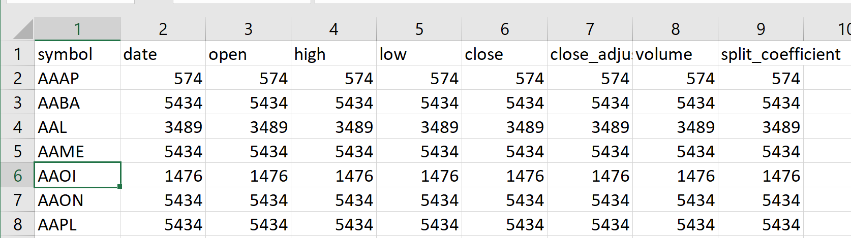
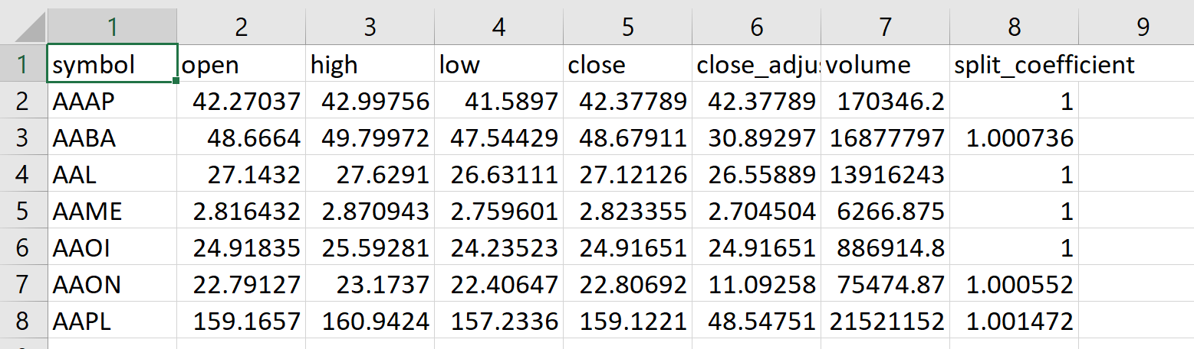
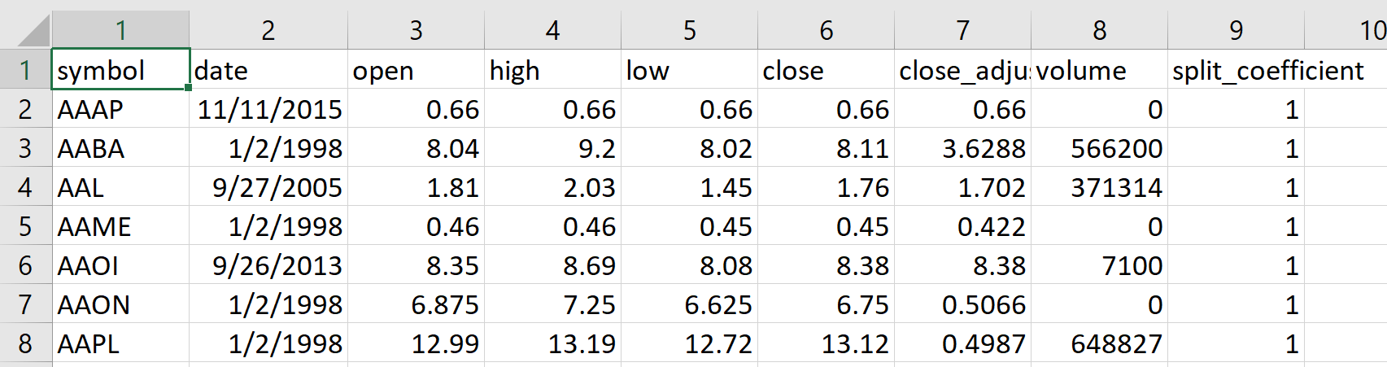
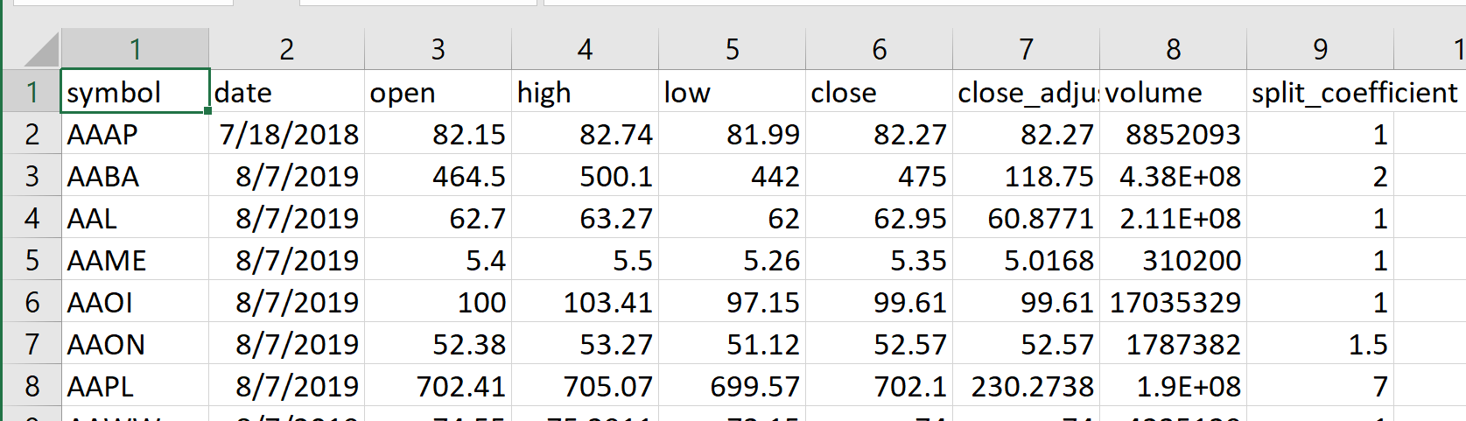
Exploring the data
Pandas: 57 Seconds
Dask: 189 Seconds
Count
Mean
Minimum
Maximum

Slide 5
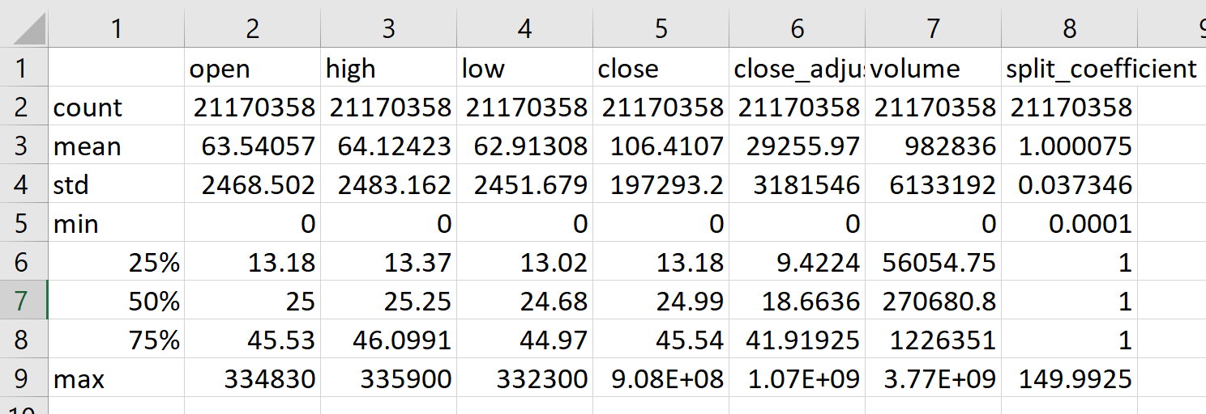
Data cleaning and sampling
There were negative values. Replaced all negative stock values to 0.
There are no missing values. However, Saturday and Sunday data are not present because the stock market closes on those days.
To speed up testing, a 5% sample was created to debugging
(It still failed to load in excel.)

Slide 6
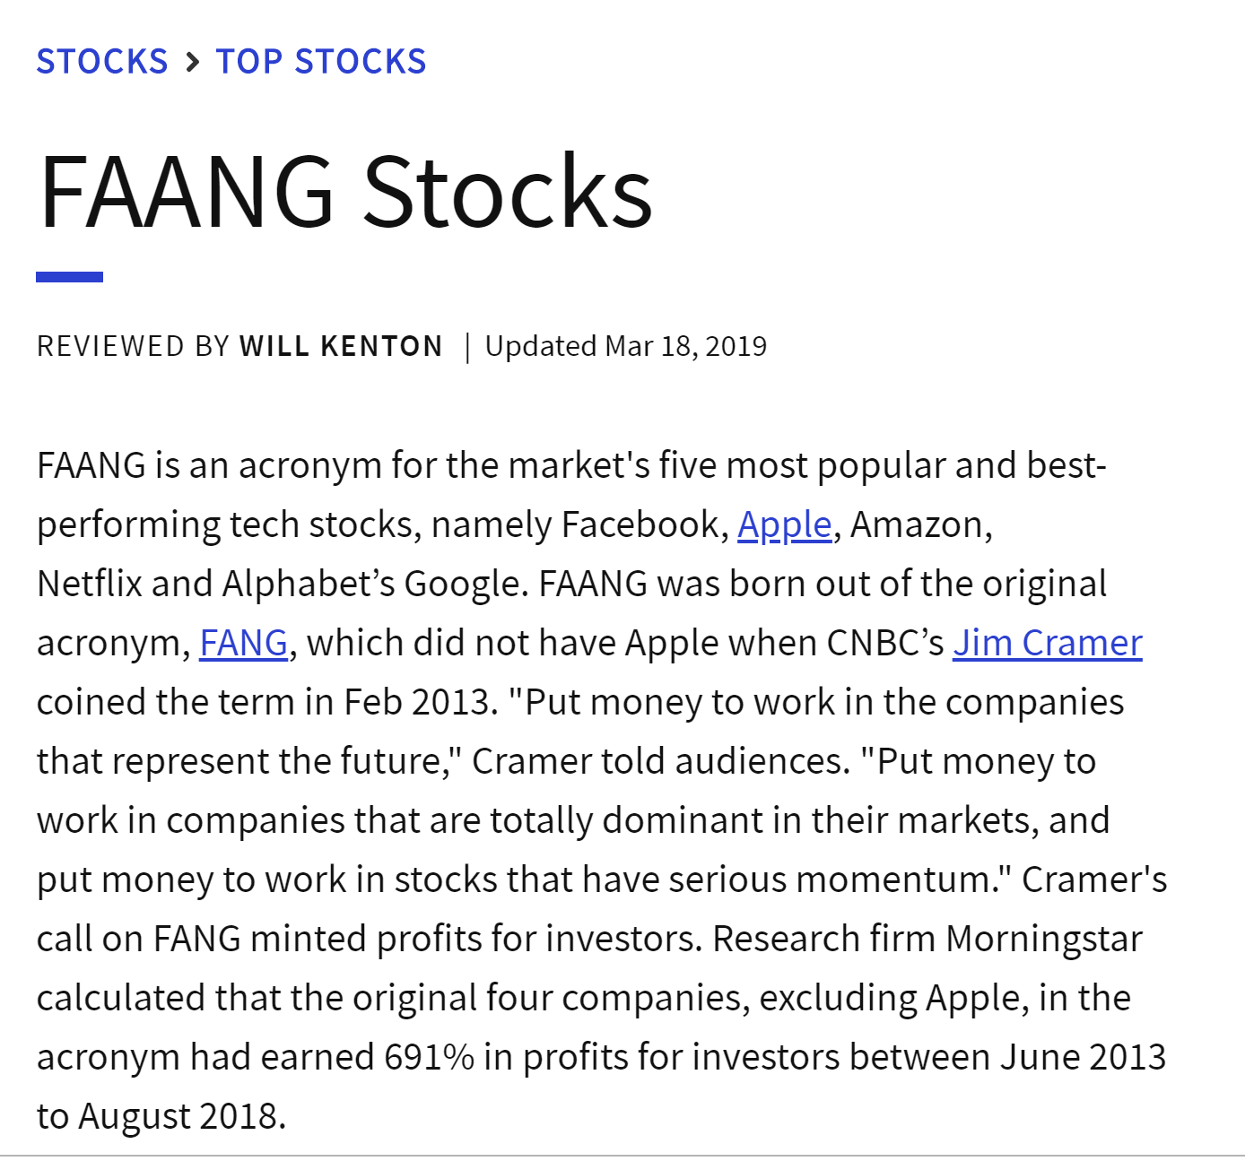
Data Selection process
Best-performing Tech Stocks (FAANG Stocks)
Stocks including Facebook, Apple, Amazon, Netflix, and Google
Manual selection: input stock of interest to run analysis
Data reduction
Kept: time, symbol, and close_adjusted
Dropped: high, low, open, close, and split_coefficient
Source: Investopedia.com

Slide 7
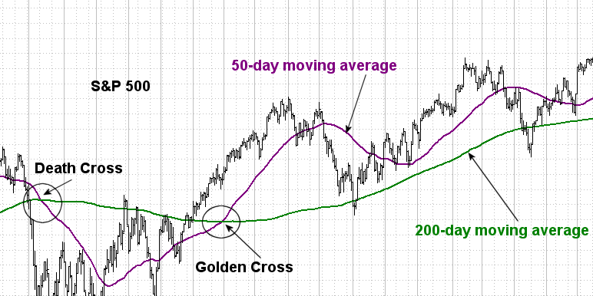
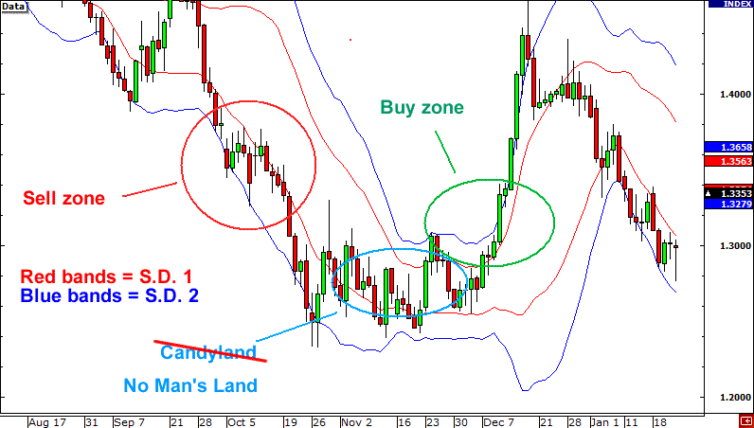
Stock analysis:
Death and Golden Cross
Using a 50 and 200 day moving average lines, we detect major changes in the stock price movements.
Golden cross – Rising market
Death cross – Falling market
Bollinger Band
2 Rolling window, then offset vertically by a standard deviation of 2 above and below the line.
when the stock price crosses upper threshold, it is an indicator to buy
When the stock crosses the lower threshold, it is an indicator to sell.
Reference:
https://www.bigtrends.com/education/moving-averages-golden-cross-death-cross-in-technical-analysis/
https://www.pythonforfinance.net/2017/07/31/bollinger-band-trading-strategy-backtest-in-python/

Slide 8
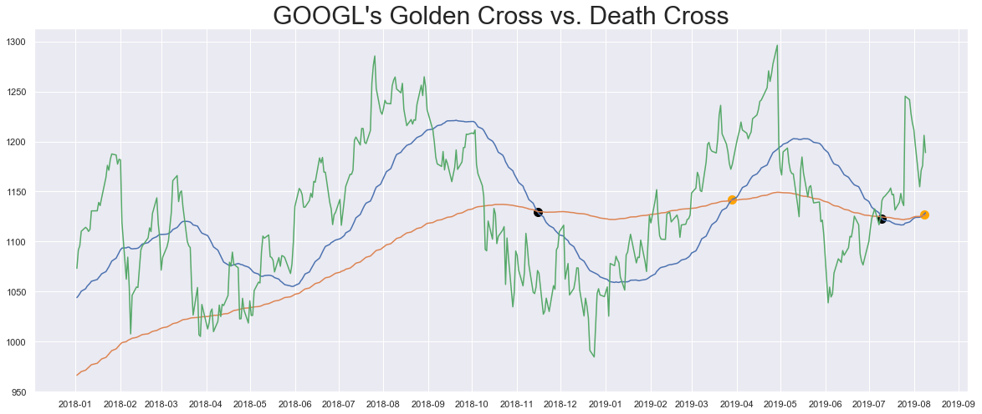
Golden and Death cross
timeframe = '2018-01-01'
50 day
200 day

Slide 9
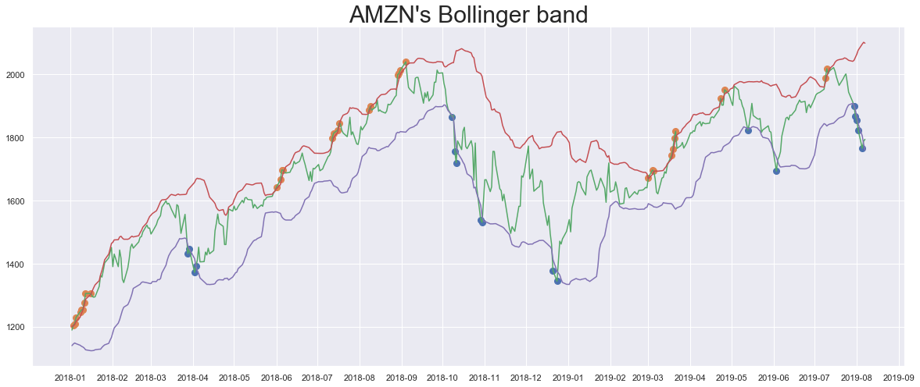
Bollinger band
Window = 20 day
No. of STD = 2
timeframe = '2018-01-01'

Slide 10
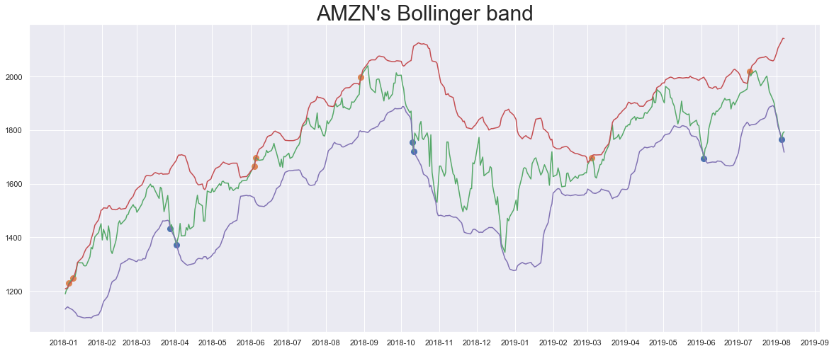
Bollinger band
Window = 20 day
No. of STD = 2.5
timeframe = '2018-01-01'

Slide 11
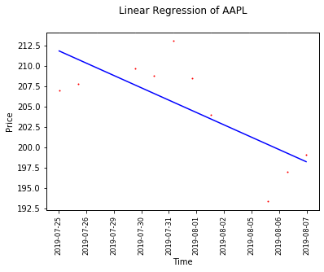
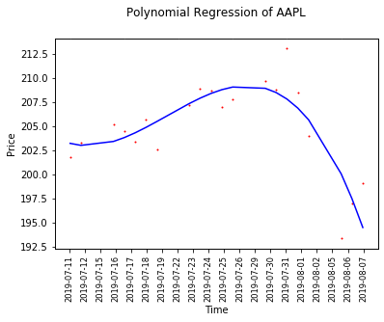
Regression Analysis Linear & Polynomial
Scikit-learn Library

Slide 12
Thank You!

